Slide 1
A PRESENTATION AT
BY: MIKE BAMILOYE
CEO- MOUNT ZION FILM PRODUCTIONS, NIGERIA

Slide 2
THE FUTURE OF FAITH BASED FILMS IN NIGERIA

Slide 3
To appreciate the current Status and the Future of NIGERIAN faith-based movies, a little throwback account of the systematic growth of Faith-Based movies in Nigeria might be necessary.

Slide 4
The wave of Faith-Based movies in Nigeria is less than 30 years old,
compared to what obtained in America especially, which has began more than a century ago.
THE First Version of "BEN HUR" (1925), and
And the Earliest Version of "King of Kings" (1927),

Slide 5
Nigerian Faith Based Movies in the Past. (1990-2010)

Slide 6
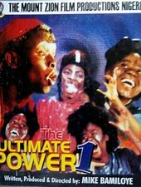
In Nigeria, we can trace the Faith-Based movie surge to the much celebrated 1993 Television Serial titled: "AGBARA-NLA" and the English version shot and released in 1994 titled "THE ULTIMATE POWER" of the scary characters like "Ishawuru" and "Ayamatangha".

Slide 7
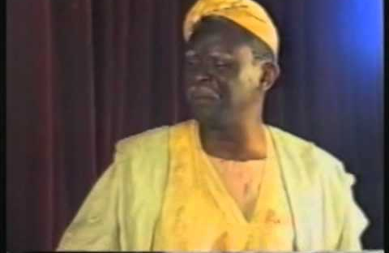
The earlier movie Releases of Mount Zion Film Productions were actually
"Unprofitable Servant" (1990),
"Beginning of the End" (1990),
“ Lost Forever” (1991)
“The Last Generation” (1992)
"Perilous Times" (1992).
Which Circulated mostly among Churches and Christian homes.

Slide 8
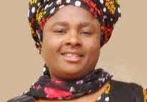
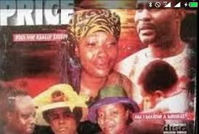
HELEN Ukpabio of Liberty Films, was another celebrated Nigerian Faith-Based movie Producer who joined the production wave when she came up with her popular movies:
"The Price",
"End of the Wicked" (1999),
"Married to a Witch", "Power To Bind', "Highway to the Grave", etc.

Slide 9
I would therefore, have to say emphatically, that,
Nigerian Faith-Based Movies, have grown systematically into better perfection and more professional standard.

Slide 10
It has not been all bad, despite the fact that, no corporate or religious sponsors do offer to take up faith based productions, because of the peculiarity of its Production Aim;
Yet, the Nigerian producers of this genre of movies have been trying their best to mount up to acceptable professional standard in their productions, which are now accepted in many Broadcast Platforms both in Nigeria and in Foreign nations.

Slide 11
AWARDS
For Example,
From Mount Zion Film Productions, there are some the National and International Awards given to her Faith-Based movies:

Slide 12
A. INTERNATIONAL AWARDS
1. BRONZE AWARD, for the Movie “ENEMY OF MY SOUL” from the Television and Cable Production Category at 38th Woridfest-Houston International Film Festival, Houston, Texas, USA I n 2005.
2. PLATINUM REMI AWARD for the Movie “YOUTHFUL LUST” from the Television Drama and Cable Production AWARD at the 40th WorldFest-Houston International Film Festival, Houston, Texas, USA in 2007

Slide 13
3. THE GOLD REMI AWARD for the Movie “THE BROKEN PITCHER” from the Television Drama Category at the 42nd WorldFest-Houston International Film Festival, Houston, Texas, USA in 2009
4. The SILVER REMI AWARD for the Movie “THE PRODIGAL ONES” for the Television and Cable Production Award (Television Series- Dramatic) at the 42nd WorldFest-Houston International Film Festival, Houston, Texas, USA in 2009

Slide 14
THESE ARE JUST TWO OF THE SEVERAL AWARDS FROM SECULAR FILM FESTIVALS, AND NOT EVEN FROM FAITH-BASED FILM FESTIVALS.
And that is the journey of the Nigerian Faith Based Movies from the past.

Slide 15
NIGERIAN FAITH-BASED MOVIES

Slide 16
* Many faith-based movies and television serials are on many Nigerian TV channels, Cables and Online Platforms
* Many Cable and Satellite TV are broadcasting many Nigerian faith-Based movies in many AFRICAN nations and many Foreign Countries for the Africans in diaspora.

Slide 17
* In the past, many faith-based movies are very sub-standard and unprofessionally made, but not any more, a lot of faith-based movies being produced today are of very high quality, and suitable for the CINEMA
* A lot of Production-Crew are arising from among the Nigerian faith-based Production Circles: Like Movie Producers, like Directors, Producers, Script-Writers, Make-up Artistes, Costumiers, fantastic Set-Designers and Special Effect specialists.

Slide 18
* It is interesting to know that many movies made by production outfit like Mount Zion Film Productions, are been translated to some other AFRICAN languages: like Lingala, Portuguese creole, French, and Swahili, Hausa, etc. by African indigenous missionaries, to aid their mission works.

Slide 19
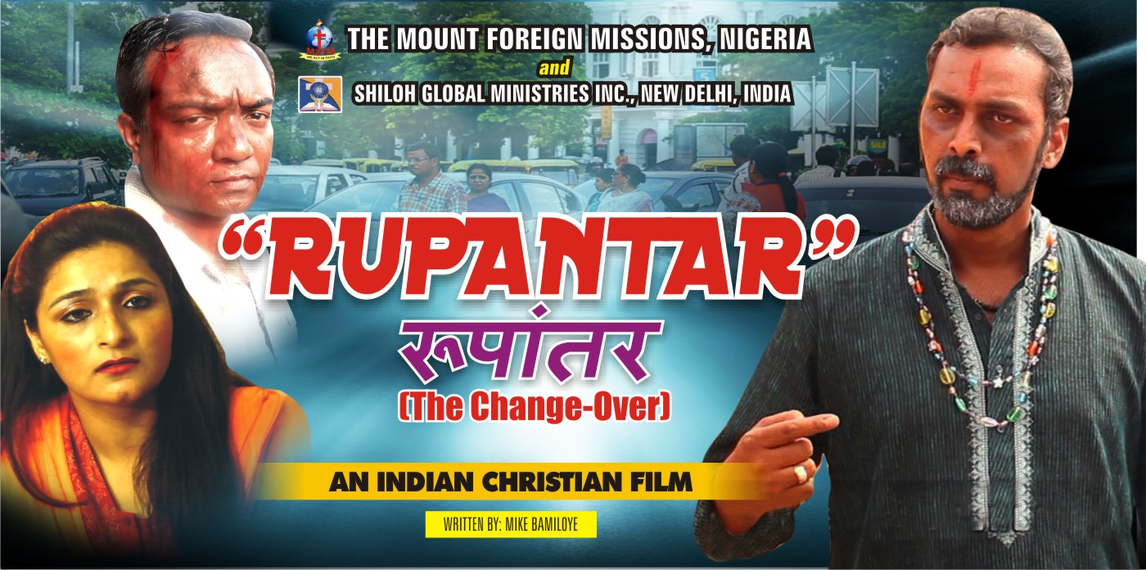
* The Mount Zion Film Productions have had a lot of joint movie production with many foreign based churches and organisations, after holding training with them.
* We have had Joint Movie productions in countries like: Canada, Spain, UK, Australia, United States, India, etc.

Slide 20
ABEJOYE – The Kingmaker (2017)
A good Example of a good Faith-Based movie that could break up the Box Office is ABEJOYE-the Kingmaker, which was premiered in more than 360 VENUES in Nigeria, USA, Belgium, Spain, Canada, Australia, Tasmania, Cameroom, UK.
We are not sure if Cinema could take the audience of the Movie. Neither are we sure a Cinema could accommodate the Duration of the movie (2hrs 48mins)

Slide 21
ABEJOYE – MOVIE SERIAL
The highly celebrated Movie-Serial, of the Mount Zion Film Productions, are “ABEJOYE Seasons 1-4, (SHOT IN FOUR YEARS) since the first serial was released in 2017, the Movies have been Premiered in more than 550 Venues in Nigeria, Cameroon, UK, USA, Canada, South Africa, Belgium, Spain, Germany, India, Finland, Scotland, Kuwait and some other countries in Europe, Africa, Australia and Tasmania Island.

Slide 23
“THE TRAIN- Movie” (2020)
One of the Most Celebrated Nigerian Faith-Based movie is “THE TRAIN- The Journey of Faith” the Biopic Movie of the life of Mike Bamiloye, Written and Produced by Damilola Mike-Bamiloye, which hit ONE MILLION VIEWS within 15 Days of its Release on YouTube and remained as Number 1 Trending Movie on YouTube for 2 straight Weeks.

Slide 24
Presently as at NOW, in a space of One and half Years, THE TRAIN stands at 2.4m Views

Slide 25
THE LEGION – the movie
The Very latest of Mount Zion Films is LEGION released on YouTube about a week ago has clocked 564,000 Views .

Slide 26
WHAT IS THE FUTURE OF NIGERIAN FAITH-BASED MOVIES?
1.* A Faith-Based movie that would go to the cinema, must be very Captivating, Socially, Technically and Spiritually balanced in a way that would not confuse the viewers.

Slide 27
NO. 2
* The movie must be very strong in Socio-Spiritual Messages, addressing the common problems of the society and proffering the sound Spiritual and logical Solutions

Slide 28
* The Picture and Sound quality must be genuine and professional.
* The Faith-Based movie that would go to the cinema, must be Spiritually compelling and be highly inspiring.

Slide 29
AND WITH ALL THESE COMPELLING EVIDENCE OF GREAT RESULTS FROM SOME OF NIGERIAN FAITH BASED MOVIE PRODUCTIONS,
IT IS CERTAIN, THAT THIS GENRE OF MOVIE PRODUCTION HAS BECOME A FORCE TO RECKON WITH IN THE CALIBER OF MOVIES THAT MOVE THE AUDIENCE AND CREATE TO LASTING SOLUTIONS TO THE PROBLEMS OF THE SOCIETY.

